Slide 1
Essay on the Principle of Population
Directly impacted Jefferson’s thinking:
Malthus predicts population explosion leading to massive poverty in both Europe and America.
Jefferson was not threatened but allowed him to emphasize the need for territorial expansion.

Slide 2
Jefferson’s Reversal of early Federalist Policies
Restoring Republican Ideals:
Cut internal taxes, including tax on Whiskey
Reduce the size of army and navy
Reduce government staff
Eliminate the National Debt

Slide 3
Louisiana Purchase
Motivation:
In order to secure the development of an Agrarian society for future generations.
Napoleon needed to raise revenue to wage his war, and so dropped this gold mine in our laps.

Slide 4
Marbury vs. Madison
Is the Judicial Branch independent of politics?
“It is the duty of courts to say what the law is.”
John Marshall
Establishes the principle of Judicial Review
Marbury (The Federalist) loses commission on Federal court.
Reaffirms checks and balance system, with courts overseeing acts of Congress.

Slide 5
Marshall’s Court
Made various decisions that affirmed the power of the Federal government over State governments.
Supreme Court becomes a strong nationalizing force.

Slide 6
Impressment
Jefferson’s Inaugural:
Foreign policy of “peace, commerce, and honest friendships with all nations, entangling alliances with none.”
America looked to profit off of their neutrality status in the Napoleonic Wars.
Britain begins stopping trade ships and forcing American citizens into the British Navy. “Once a British subject, always a British subject.”
Americans protest these acts.

Slide 7
The Embargo Act
Jefferson wanted to reaffirm our right to trade as a neutral, without getting involved in this Foreign conflict.
To force Britain and France to honor their neutral rights, Jefferson passed this act which forbade American ships from sailing to any foreign port.
RESULTS: The economy came to a standstill.
Many captains refused to follow it and Federalists sprang back to life with attacks on Jefferson.

Slide 8
Indian Intercourse Act
1790: U.S. could only acquire Indian lands through official treaties.
However, American settlers came pushing forward.
Jefferson asks territorial governors and settlers to begin promoting the “Civilization of the Indian peoples.”
Indian tribes resists, governors resist, settlers resist.
CONFLICT not resolved.

Slide 9
The War Hawks
Advocated action against the Brits:
Motivation…
Settle conflict over rights of neutrals.
End Impressment of American citizens.
Establish Independence with authority and defend our young honor.
Annoyance at British support for western indians.

Slide 10
The Hartford Convention
Example of the discontent caused by this war.
New Englanders, opposed to the war, call convention and speak of nullification.
State governments should protect their people against Federal policies that are harmful. Talks of secession, AGAIN, like with Virginia and Kentucky Resolutions.
AND THEN THE WAR ENDS.

Slide 11
Treaty of Ghent
About as significant and exciting as the war itself.
No talk of neutrality or impressment, but the British back off.
No major victories, but Battle of New Orleans, but the British call it quits.
British support for Indians in West withdrawn… THIS WAS BIG.

Slide 12
Land Act of 1820
A great surge of settlers unfolded as land is given away “Dirt” cheap with a minimum purchase of 80 acres.
Percentage of the population living West of the Appalachians was quickly growing.

Slide 13
The Era of Good Feelings
James Monroe’s Presidency
Emphasis on National Unity and desire to work with old school Federalists.

Slide 14
The American System
Monroe breaks with traditional Jeffersonian views and promotes economic development through a NATIONAL BANK, TAXES on imports, National system of canals and roadways.
“I Think these were Hamilton’s ideas.”
Reality, in order to benefit both farmers and merchants alike, the Fed. Gov’t needed to manage the economy.

Slide 15
Monroe Doctrine
John Quincy Adams negotiates:
End of European colonization in the Western Hemisphere.
We would take this as an immediate threat and respond.
We’ll stay out of your hair also.
America solidifies its place on the Continent, in the Hemisphere, on the World’s stage.

Slide 16
The Panic of 1819
The economy deflates after the war.
Farmers suffer greatly, blame the “NATIONAL BANKS.”
Clearly we were not a collection of yeoman farmers, when a decline in commerce can ruin everybody.
This is not what Jefferson had envisioned.

Slide 17
The Missouri Compromise
Have we talked about slave or free yet?
Missouri wants to be a state. Big whoop.
Slave vs. Free 11-11 in the Senate. Neither wanted to give up one more.
Henry Clay, The Great Pacifier, proposes.
MAINE = FREE MISSOURI=SLAVE
Divide Louisiana Purchase in two, with more FREE territory than SLAVE.
THIS PROBABLY ISN’T OVER.

Slide 18
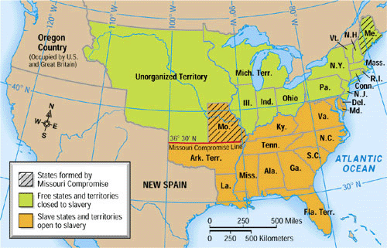

Slide 19
Lewis and Clark Expedition
Discovering the “Empire of Liberty.”
Sent to survey the West and find an overland route to the Pacific.
This kick starts a century of continental expansion that had a major impact on the political, social, and economic scene of America.

